Slide 1

MGMT 585 - Airbnb| Impact of Covid on Airbnb bookings in Chicago and Boston
Data Mining – Bankruptcy Classification Project
Team Scrum Sprinters: Akanksha Singh, Chinmay Gidwani, Devarshi Sharma, Harshraj Jadeja, Keertana Madan
Notes:
HS

Slide 2








1
Agenda
Resolution Framework
Introduction
Airbnb & COVID-19
MS Project & Smartsheet
WBS, User Stories, Resource allocation.
Data Modelling
Tried multiple models to train our data
Problem Statement
Reshaping Travel: Navigating the Airbnb Journey Through the Pandemic and Beyond
Data Modification & EDA
Prepared our Data for Extensive Data ModelingData Set Description and
Identification of trends & patterns in raw data
Business Insights & Way Forward
Recommendations for the stakeholders and future scope
Project Objective
UTILIZE GIVEN DATA SETS ON AIRBNB TO SOLVE REAL TIME PROBLEMS USING ROBUST MODELING TECHNIQUES

Slide 3
Introduction

Slide 4
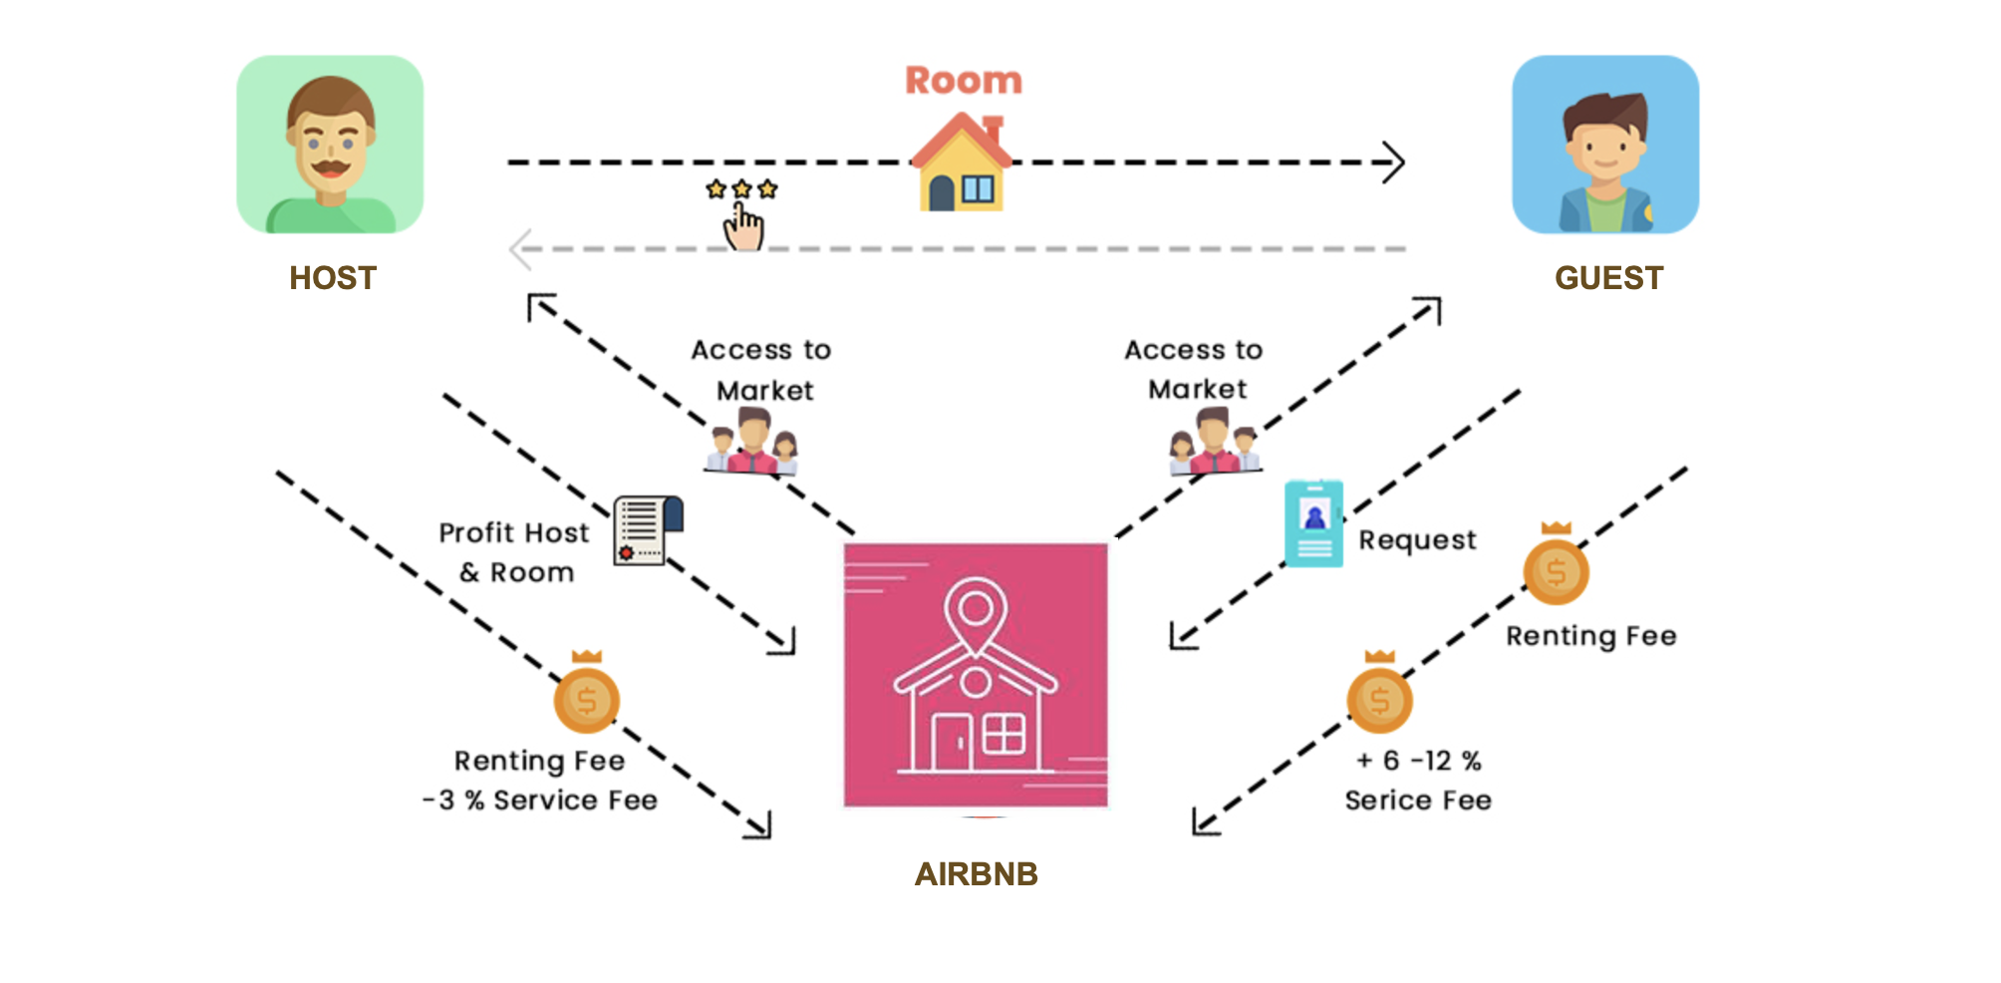
1
Airbnb Business Model
Insight into Stakeholders within a Platform-Based Airbnb Business Operations.

Slide 5
Problem Identification

Slide 6



1
Problem Statement
Reshaping Travel: Navigating the Airbnb Journey Through the Pandemic and Beyond
The COVID-19 pandemic has exerted profound and multifaceted impacts on urban centers globally, with cities like Boston and Chicago experiencing unique challenges and responses due to their distinct socio-economic landscapes, population density, and governance structures.
Consumer Shifts: Unveiling a dramatic pivot in traveler preferences towards secluded, longer stays and work-friendly accommodations.
This study seeks to uncover and analyze the comprehensive impact of the COVID-19 pandemic on Boston and Chicago, focusing on key areas such as public health outcomes, economic disruptions and recovery efforts, changes in urban mobility and public transportation usage, the efficacy of social services and support systems in addressing the pandemic-induced needs, and the adaptive strategies implemented by local governments to manage the crisis.
Geographic Redistribution: Highlighting a marked migration of bookings from bustling cities to tranquil, rural escapes.
Host Adaptability: Showcasing the resilience and innovation of Airbnb hosts in enhancing safety and flexibility for guests.
Additionally, the study aims to explore the shifts in community behavior, resilience, and innovation in response to pandemic-related restrictions and fears.
Business Evolution: Revealing Airbnb's strategic transformation to navigate market shifts and redefine its role in the future of travel.
Problems Identification
Consumer Behavior Change? Rural vs Urban Demand? Hosts' Response Effective?
Airbnb's Strategic Shifts?

Slide 7
MS Project & Smartsheet

Slide 8
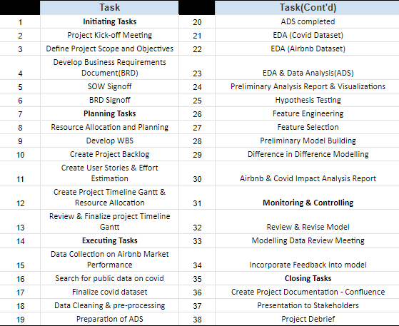
1
WBS
Implemented a comprehensive, multi-faceted strategy to pinpoint real-time challenges experienced by all stakeholders in a platform-based business model

Slide 9
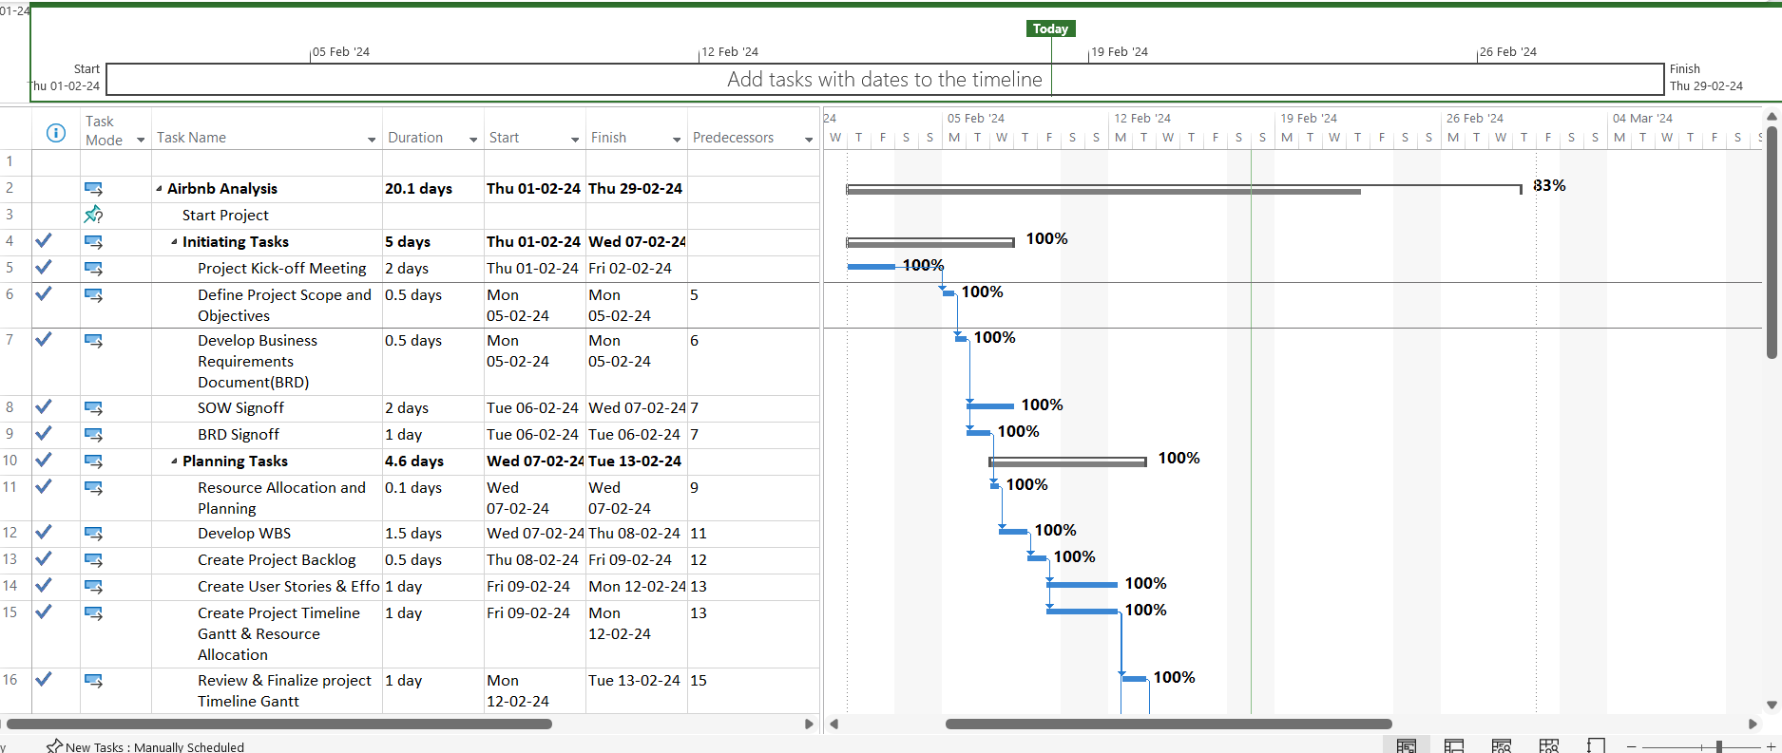
1
Gantt View

Slide 10
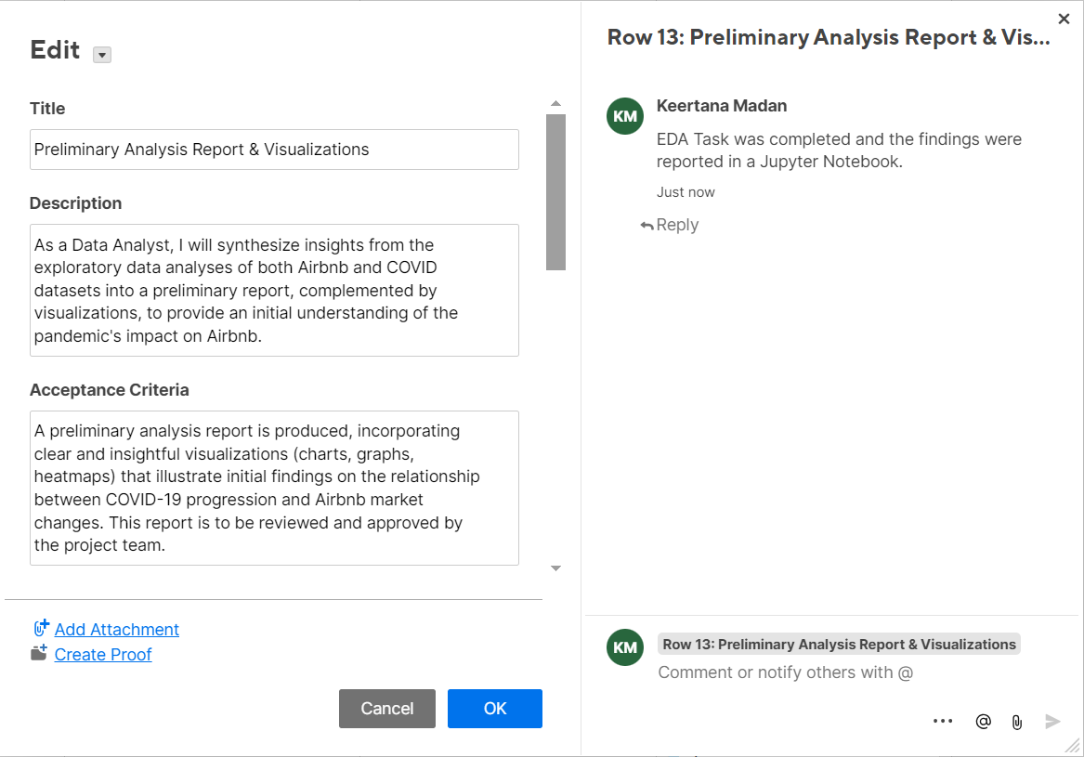
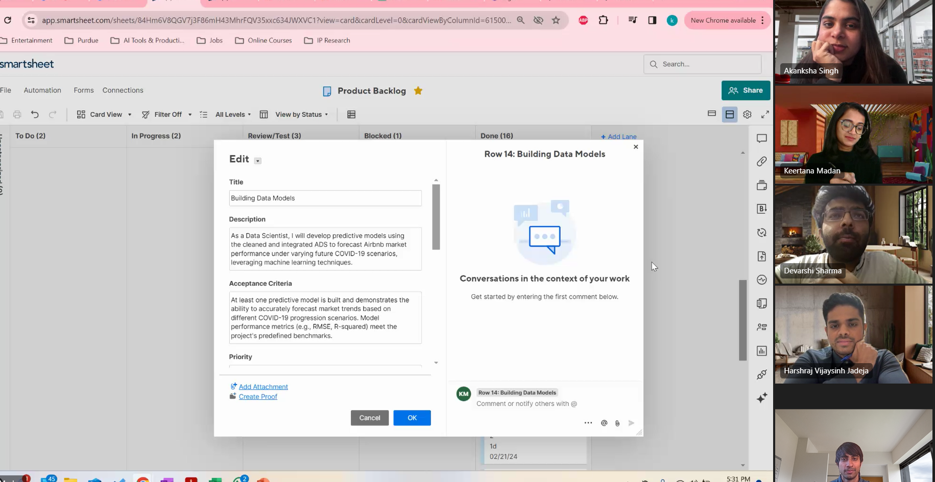
1
User Stories & Tasks Planning
Story Creation Workshops
Conducted workshops
Curated List of tasks for project
Organised list into Stories & Tasks
User Story Format
Created Stories using As a, I want, So that
Defined Acceptance Criteria for completion

Slide 11
Effort estimation
Estimates
Experienced team members assign fibonacci points
Team weighs in with their estimates
Discussion ensured difference in opinions were addressed
Learning reincorporated into effort estimation
Planning
Poker
Collaboration
Buy-Ins
Final estimate decided on concensus

Slide 12



User Story prioritization
Dependancy Mapping
Risk Assessment
Backlog
List of all stories and tasks ordered
Dependency mapping influenced the prioritization to ensure a logical flow in project timeline
High risk tasks like “Hypothesis Testing" & "Feature Engineering" addressed early in timeline

Slide 13
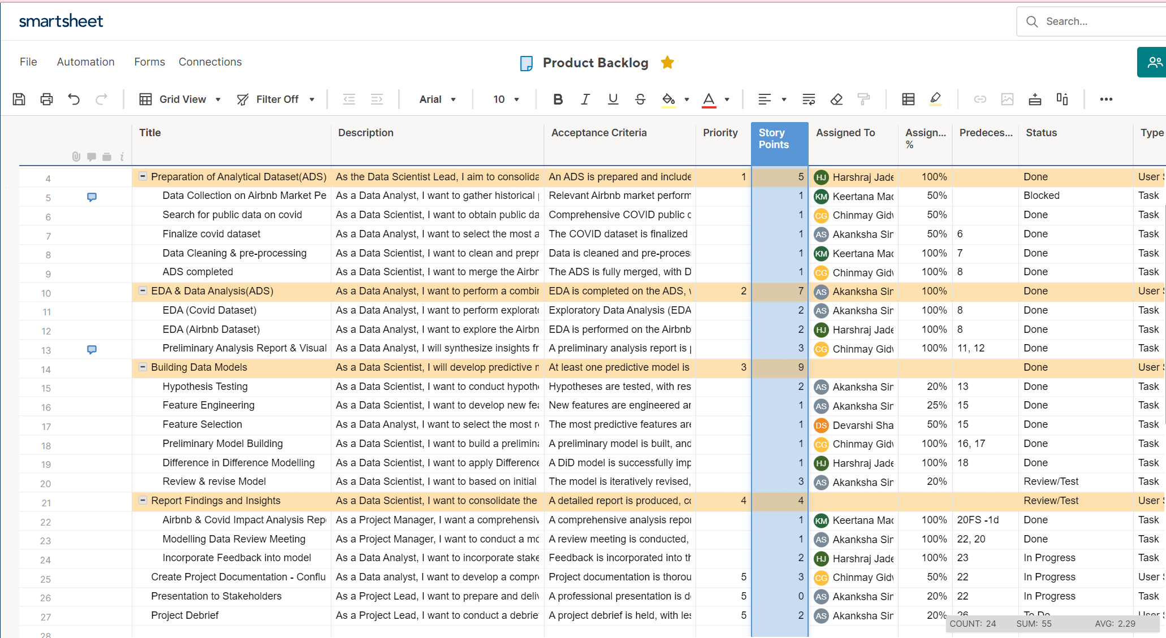
1
Project Backlog
7 User Stories, 17 Tasks

Slide 14
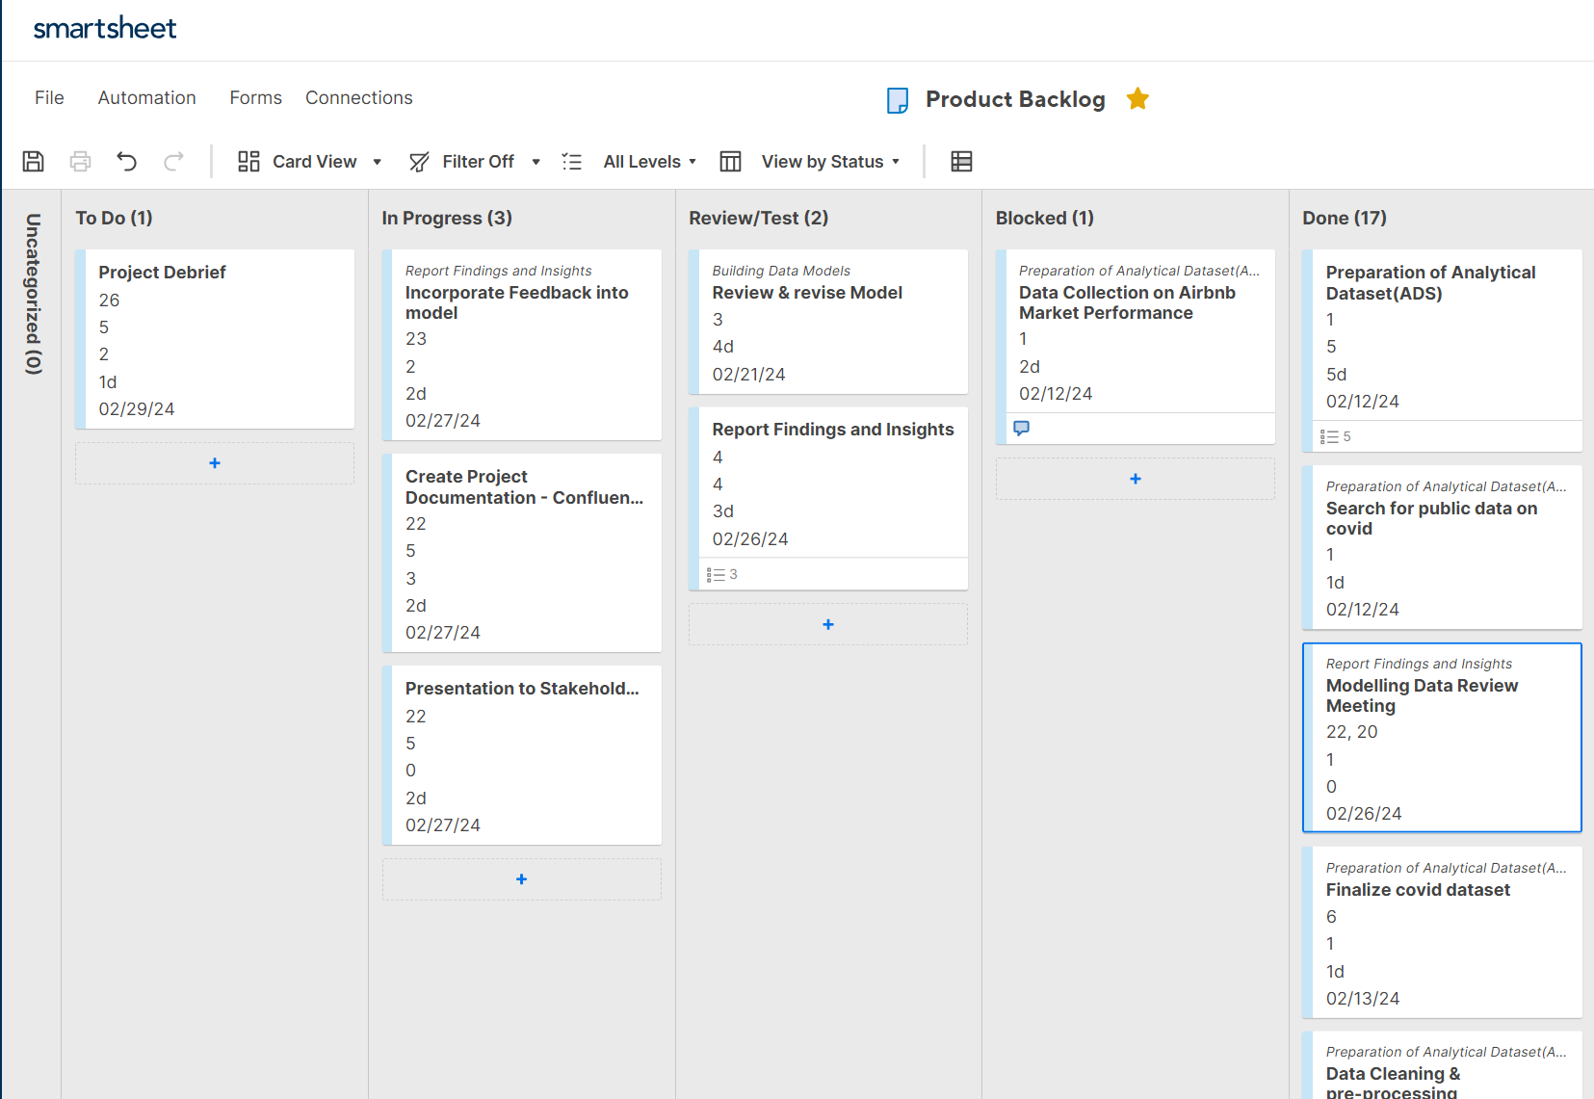
1
Kanban Board
3 In Progress
17 Completed
1 Blocked
1 To Do

Slide 15







1
Data Set Information - Airbnb
Implemented a comprehensive, multi-faceted strategy to pinpoint real-time challenges experienced by all stakeholders in a platform-based business model
No. of Rows & Columns
121K Rows & 111 Columns
Average Booked Days
26 Days Booked
Time Period
16 periods
Average Occupancy Rate
19% Occupancy
Total No. of Hosts
13.6 K Hosts
Average Revenue
$3,301
Super Hosts Status
~4,600 Hosts
Average Rating Overall
94%

Slide 16



1
Data Set Information - COVID
Implemented a comprehensive, multi-faceted strategy to pinpoint real-time challenges experienced by all stakeholders in a platform-based business model
Chicago
2,697,000 population
Boston
654,776 population
No. of Cases
320,000
No. of Cases
77,500
Time Period
2 periods
Time Period
2 periods
No of Deaths
7,150
No of Deaths
2,170

Slide 17
Exploratory Data Analysis

Slide 18
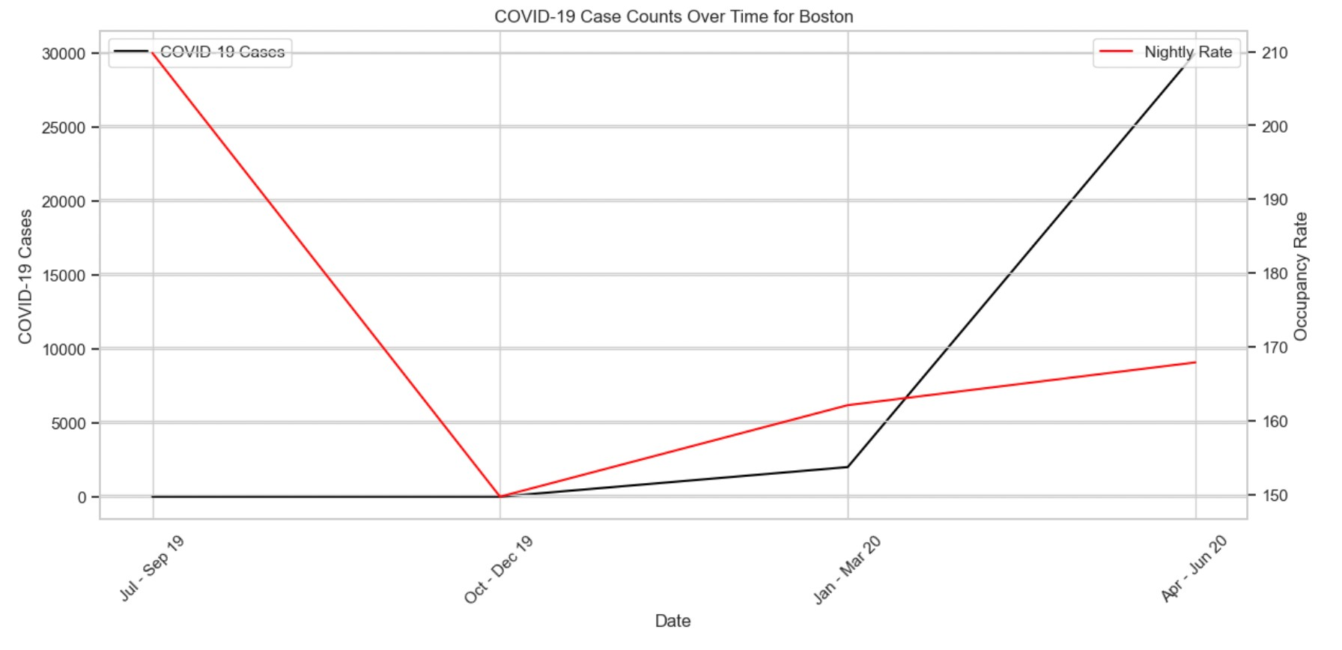
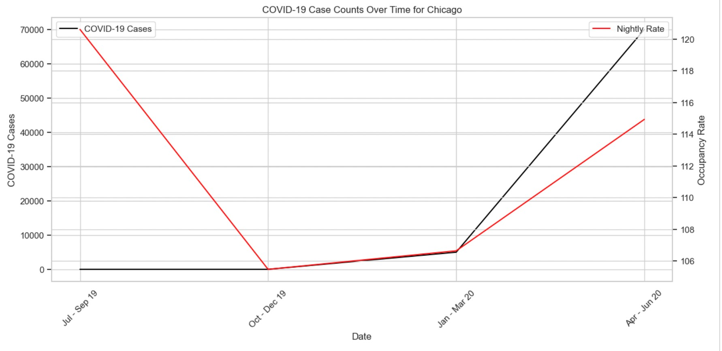
1
Exploratory Data Analysis
Exploratory Data Analysis indicating the COVID-19 case count over time.
From the first graph for Chicago:
The graph shows a sharp increase in nightly rates that coincides with a decrease in COVID-19 cases, indicating a potential correlation where the decrease in cases might contribute to a higher willingness to pay more for accommodations.
From the second graph for Boston, we can infer:
The trend is similar, with the nightly rates increasing as COVID-19 cases decline. This could reflect a recovery in the travel and accommodations sector, with higher rates suggesting a rebound in demand as the perceived risk associated with traveling decreases.

Slide 19
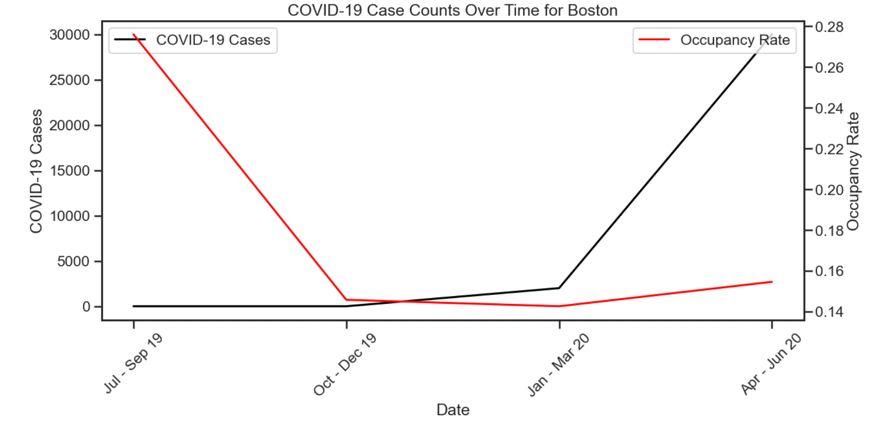
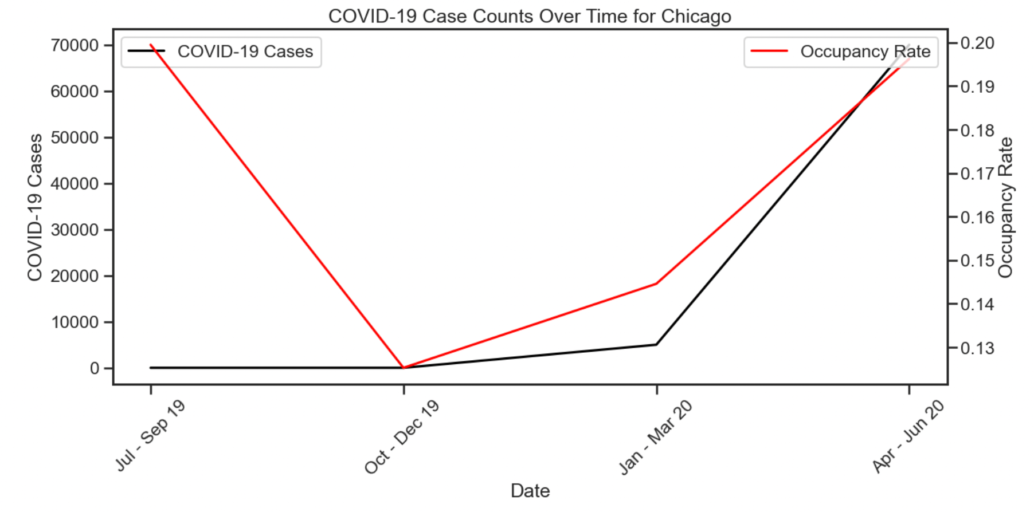
1
Exploratory Data Analysis
Exploratory Data Analysis indicating the COVID-19 case count over time.
From the first graph for Boston:
Correlation between Cases and Occupancy: There seems to be an inverse relationship between the rise of COVID-19 cases and the occupancy rate, suggesting that as cases increased, the occupancy rates decreased.
Recovery Signs: The occupancy rate begins to recover around April - June 2020, which could indicate a possible adaptation to the pandemic conditions or the implementation of safety measures that restored traveler confidence.
From the second graph for Boston, we can infer:
Greater Impact on Occupancy: Chicago's occupancy rates also show a decline as COVID-19 cases rise, but the drop appears more significant compared to Boston, which might reflect stricter lockdown measures or a higher impact of the pandemic in this city.
Rapid Rebound: Like Boston, there is a rebound in occupancy rates as cases start to decline. However, the recovery in Chicago seems to be more pronounced and rapid, potentially due to various factors like the lifting of restrictions or seasonality effects.

Slide 20
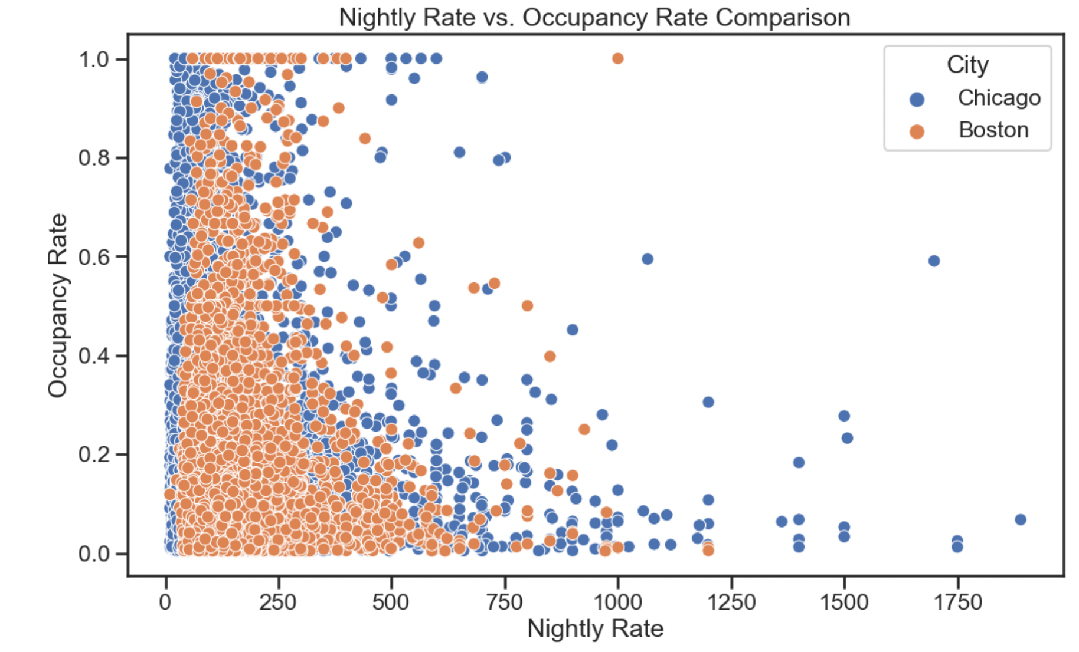
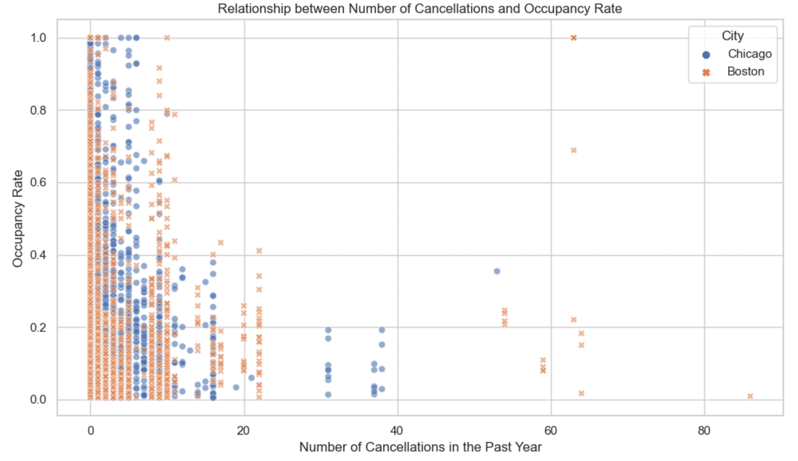
1
Exploratory Data Analysis
Nightly Rate vs Occupancy Rate & Number of Cancellations vs Occupancy Rate
The scatter plot suggests that lower-priced Airbnb listings generally achieve higher occupancy rates, with Chicago showing a denser concentration of high-occupancy, lower-cost options compared to Boston.
The scatter plot suggests a common trend in both Chicago and Boston, where Airbnb listings with fewer cancellations tend to have higher occupancy rates.

Slide 21
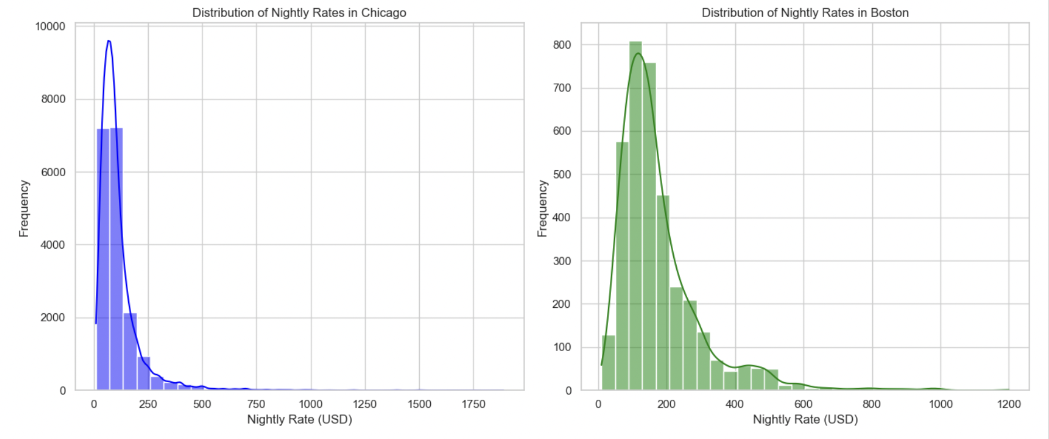
1
Exploratory Data Analysis
Distribution of Nightly Rates
The histogram for Chicago indicates a high frequency of Airbnb listings concentrated at lower nightly rates, with a steep drop-off as prices increase
Boston's distribution shows a broader range of nightly rates with a more gradual decline in frequency as rates rise.

Slide 22
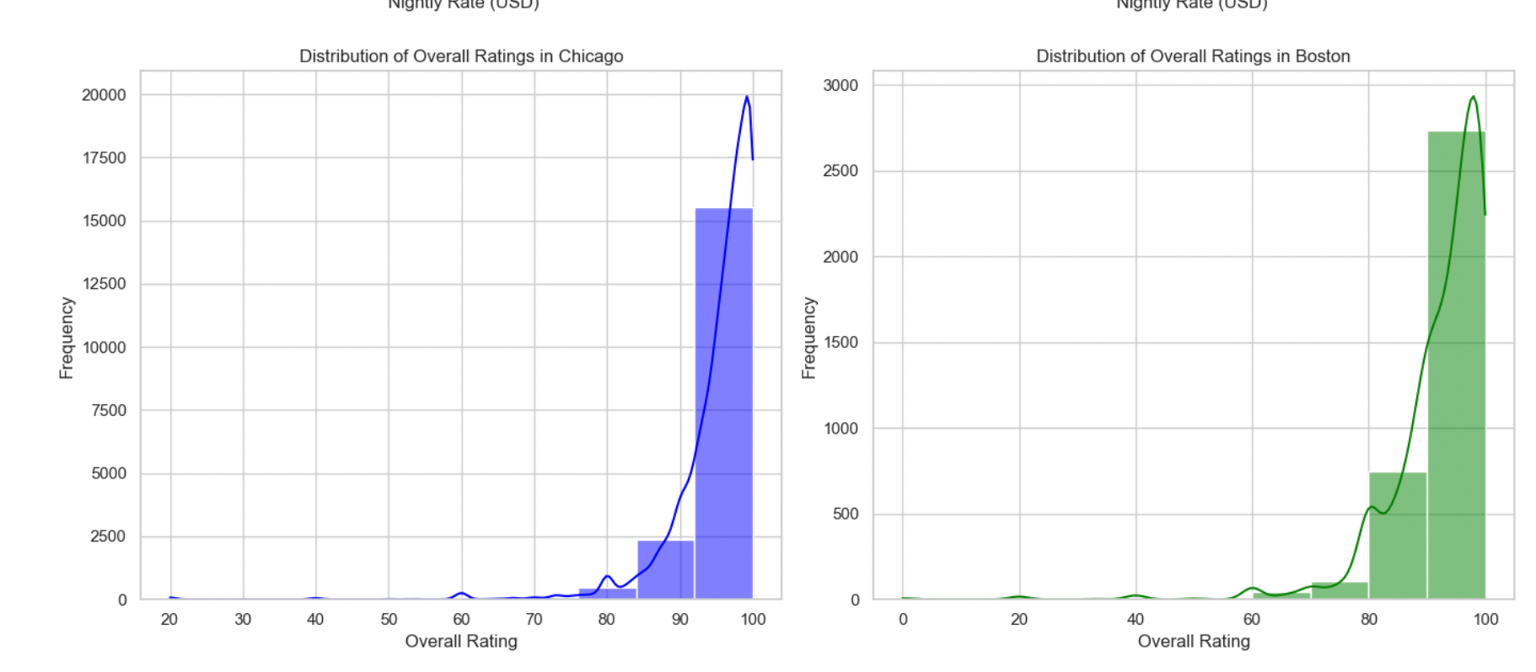
1
Exploratory Data Analysis
Distribution of Overall Ratings
The histogram for Chicago shows a predominant concentration of Airbnb listings with high overall ratings, skewing towards the upper end
Boston's distribution also suggests a high frequency of listings with top ratings, with a slightly more even spread across the rating spectrum.

Slide 23
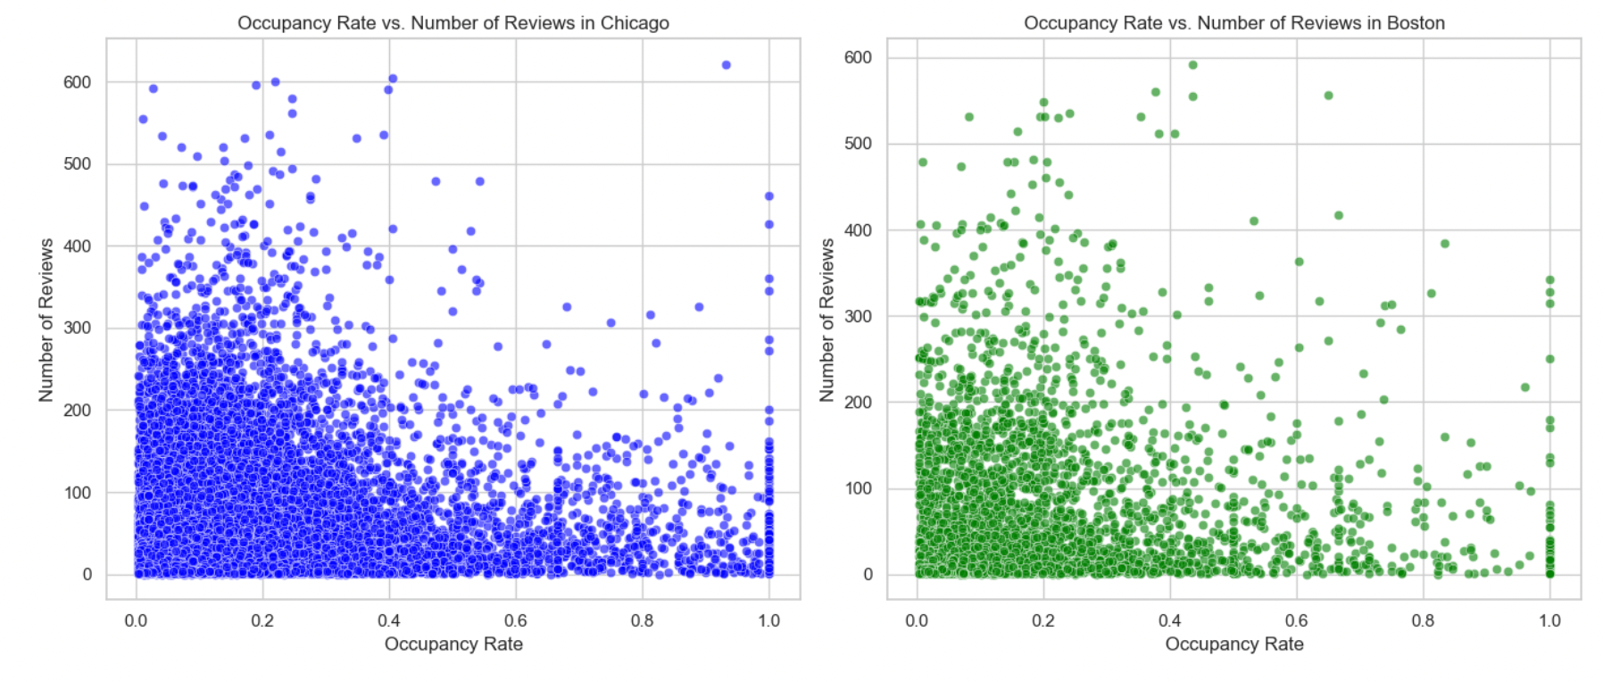
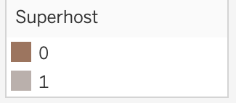
1
Exploratory Data Analysis
Occupancy Rate vs Number of Reviews
In the scatter plots, Chicago's Airbnb listings show a dense cluster at lower occupancy rates regardless of the number of reviews
Boston's plot displays a more even spread across occupancy rates with a similar pattern of reviews.

Slide 24
Data Modification

Slide 25







Data Preprocessing
Layer 1 – Feature Selection & Data Ingestion | Removal of irrelevant features, to increase reliability
Data Sources
Handling Highly Correlated Features and Outliers
Airbnb dataset
Correlation
111 Features
Correlation Check
Dropping highly correlated features
Relevant Feature Selection
Ingestion
Outlier Detection
Understanding
Outliers
Interpretation
Analytical Dataset (ADS)
Box-Plots Creation
No Alarming Outliers Detected
Dropping the features that are highly correlated (>0.9)
15 Relevant features

Slide 26

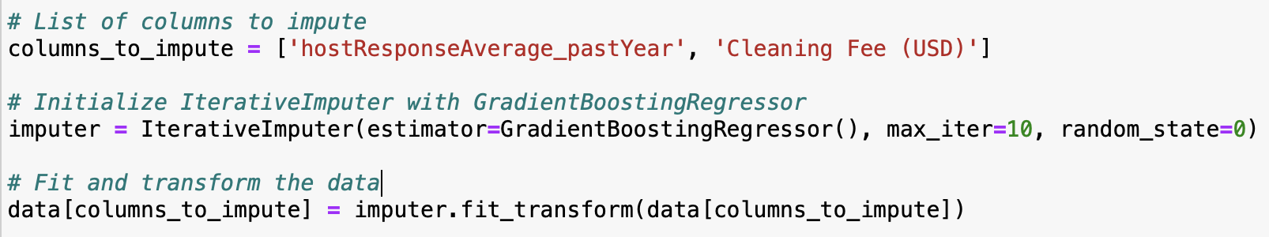
Data Preprocessing
Layer 2 – Handling Missing Values | A significant proportion of the dataset contains nulls, hence, making this layer significant
Handling Missing Values
Nulls remaining
Feature | Null count | Null percent
Property Type | 3 | 0%
Minimum Stay | 3 | 0%
Number of Photos | 8 | 0%
Max Guests | 11 | 0%
Bedrooms | 17 | 0%
Number of Reviews | 27 | 0%
Bathrooms | 88 | 0%
Neighborhood | 3003 | 2%
numReserv_pastYear | 7398 | 4%
hostResponseAverage_pastYear | 12074 | 7%
available_days | 23449 | 14%
available_days_aveListedPrice | 23449 | 14%
Rating Overall | 24372 | 15%
Cleaning Fee (USD) | 32537 | 19%
numCancel_pastYear | 34466 | 21%
numReviews_pastYear | 34466 | 21%
prop_5_StarReviews_pastYear | 35856 | 21%
rating_ave_pastYear | 35856 | 21%
booked_days | 55982 | 33%
occupancy_rate | 55982 | 33%
revenue | 55982 | 33%
hostresponseAverage_pastYear 977
Cleaning Fee (USD) 11730
Dropping Null records with low proportion
Gradient Boosting | Null Imputation
Gradient boosting is preferred over mean imputation because –
Iterative learning process
Can model complex relationships in the data
Captures non-linear relationships between features
Generally robust to outliers
Dropping Null Records where Prediction/Imputation can potentially bias the dataset
Dropping Null Records
Imputing nulls using Gradient Boosting

Slide 27
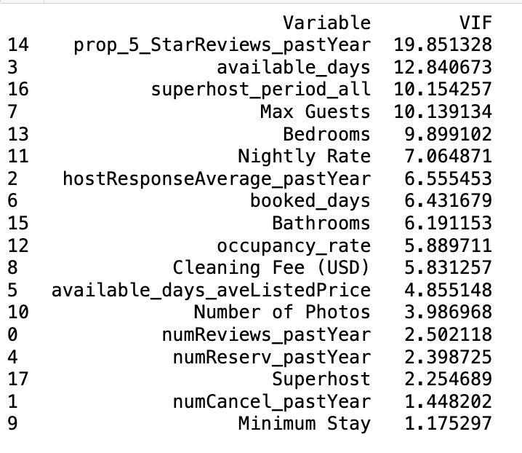
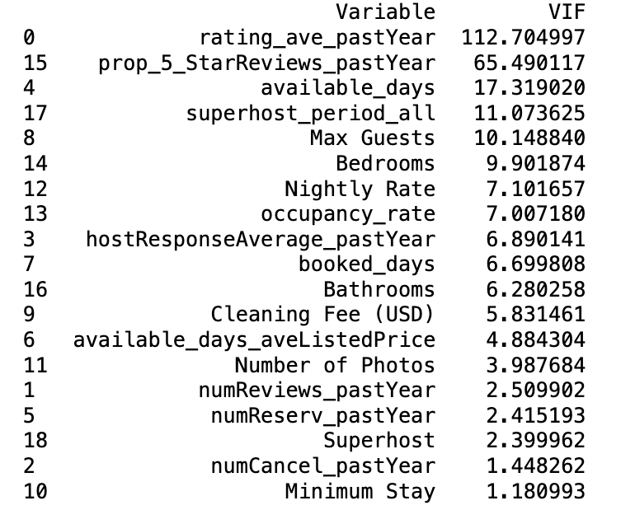
Data Preprocessing
Layer 3 – Multicollinearity Check | Removal of multicollinear features to increase the model accuracy and to mitigate the issue with correlated predictor variables
Handling Multicollinearity
Removing rating_ave_pastYear feature to account multicollinearity

Slide 28
Data Modeling

Slide 29
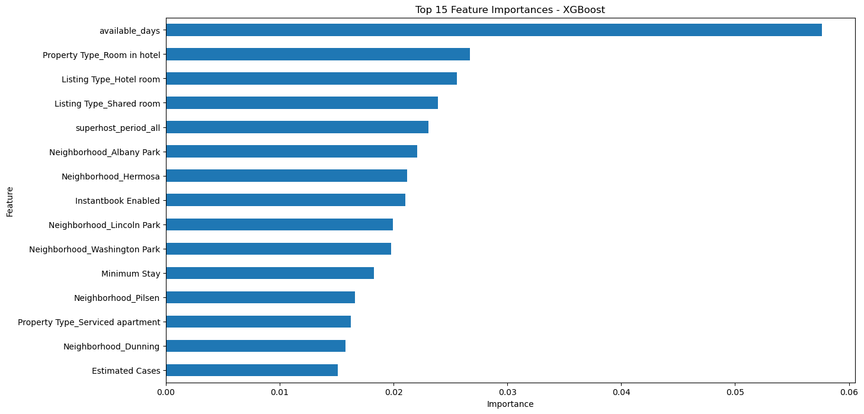
1
Data Modelling | to identify feature importance
Utilizing XG Boost for data modeling revealed key feature importance that drive the performance of Airbnb listings (target variable being Occupancy Rate)
Feature Importance
Key Takeaway
The bar chart represents the feature importance scores derived from an XGBoost machine learning model
Primary Predictor - Availability: 'available_days' emerges as the top predictor, indicating its critical role in determining the model's outcomes.
Health Data Relevance: The 'Estimated Cases' signifies that there is very little relevance of COVID-19, to the occupancy rate.
*RMSE: 0.133
*MAE: 0.088
Notes:
Root Mean Squared Error (RMSE): 0.13353793292967742
Mean Absolute Error (MAE): 0.08847003238898739
R² score: 0.42264657389077576

Slide 30
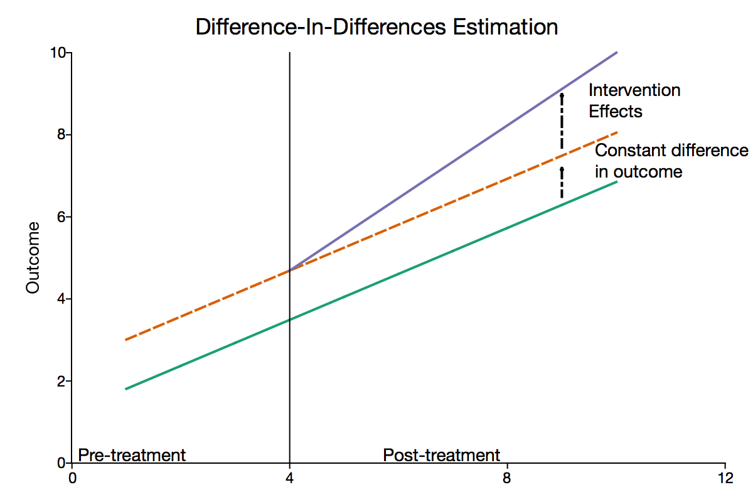
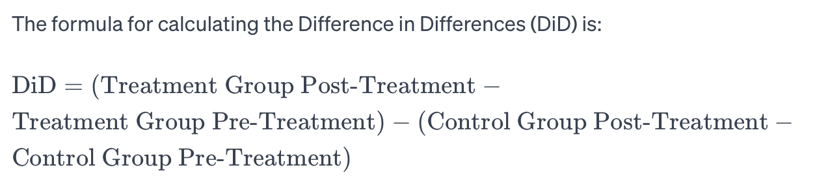
1
Data Modeling | DIFFERENCE IN DIFFERENCES ANALYSIS
The model summarizes a Difference in Differences analysis showing the impact of COVID-19 on Airbnb, with Boston experiencing a decrease in occupancy rates and revenue, while Chicago saw an increase in occupancy but a decrease in available days and booked days.
Treatment Group – The Airbnb listings after Covid cases started rising.
Control Group – The Airbnb listings before there were any Covid cases.
Treatment timeline:
Pre-Treatment – Jul ‘19 to Dec ‘19
Post-Treatment – Jan ‘20 to Jun ‘20
Average Occupancy Rate
Metric | Boston DID | Chicago DID
Booked Days | -4.183981 | -3.390298
Occupancy Rate | -0.062353 | 0.008024
Implemented a Difference in Differences approach to calculate the treatment effect of covid on Airbnb

Slide 31
Business Insights & Way Forward

Slide 32
1
Business Insights & Recommendations
Comprehensive Business Insights to deal with real-time challenges experienced by all stakeholders in a platform-based business model
Data-Driven Approach: The project emphasizes the use of robust data modeling to understand real-time challenges and Airbnb’s response to the pandemic.
Adaptive Methodologies: Agile practices like scrums and sprints and project management tools like MS Project and Smartsheet have been crucial for timely delivery and responsiveness.
Risk Management: Early identification and management of high-risk tasks such as hypothesis testing and feature engineering have been pivotal.
Collaborative Estimation: Team collaboration in effort estimation and consensus-building on project timelines has supported project cohesion.
Quality Control: Addressing multicollinearity and outliers has ensured the integrity and reliability of data modeling.
Change Management: The project includes strategies for hosts and recommendations for stakeholders, highlighting the importance of adaptability and continuous improvement.

Slide 33


1
Future Scope
Potential areas of improvement and expansion in the future phases
Expand Geographic Analysis: Extend the study to include more cities or countries to compare Airbnb's impact and recovery patterns globally.
Longitudinal Study: Conduct a longitudinal study to track changes over a longer period, capturing post-pandemic recovery phases and new trends emerging in the travel industry.
User Behavior Analysis: Deep dive into changing consumer preferences, focusing on the shift towards remote work, longer stays, and preferences for rural over urban settings.
Competitive Analysis: Compare Airbnb's performance and strategies with other accommodation and travel platforms to identify unique challenges and opportunities.
Analysis
Agile Methodology Enhancement: Refine agile methodologies used, incorporating more frequent feedback loops with stakeholders to adapt quickly to changes in the project's scope or market dynamics.
Technology Integration: Explore the use of emerging technologies (e.g., AI, blockchain) to enhance project management processes, such as automating routine
Project Management

Slide 34
Thank You!

